Slide 1
Colourization of grayscale media using GAN
Akash Raj
Chandni Mishra
Abhinav Bahuguna
Harshit Shukla

Slide 2
Generative Adversarial Networks
Pix2pix GAN model generally used for general-purpose image-to-image translation.
Takes images as an input and produces an image corresponding to the input.
Like a 2 player Game.
Consists of a Generator and Discriminator.
Generator and Discriminator are two counter parts of each other.
Generator generates an image and Discriminator judges the generated image whether it is real or fake (generated)
Main aim of Generator is to fool the Discriminator by making the Discriminator judge generated image as real
On the other side Discriminator’s aim is to judge the generated image as false

Slide 3
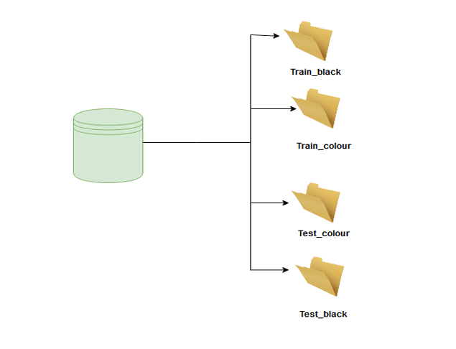
Dataset
The dataset is taken from Kaggle platform
The dataset is divided into 4 folders - train_black, train_colour, test_black, test_colour, with their corresponding colour images and grayscale images placed accordingly as demonstrated in FIG.

Slide 4
The Discriminator
The discriminator model in the Pix2Pix GAN is implemented as a PatchGAN.
The Disciminator is a convolutional neural network.
Idea of Discriminator based on Receptive field.
The receptive field is the relationship between output of the model to an area on the input image.
A PatchGAN with the size 70×70 is used, which means that the output (or each output) of the model maps to a 70×70 square of the input image.
The Discriminator Model receives 2 images (single channel grayscale and corresponding colour Image) and determines that the coloured image is real or fake.
Returns a (4x4) matrix (in which each cell denotes 70 cells in input image) comprises of values between 0 and 1.
0 Denotes that the output is fake and 1 Denotes that the output is Real.

Slide 5
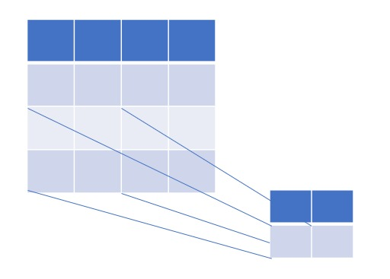
PatchGAN Visualization

Slide 6
The Generator
The generator model for the Pix2Pix GAN is implemented as a U-Net.
The U-Net model is an encoder-decoder model for image translation where skip connections are used to
connect layers in the encoder with corresponding layers in the decoder that have the same-sized feature
maps.
The encoder part of the model is comprised of convolutional layers that use a 2×2 stride to downsample
the input source image down to a bottleneck layer. The decoder part of the model reads the bottleneck
output and uses transpose convolutional layers to upsample to the required output image size.

Slide 7
Encoder Part of Generator
Encoder Downsamples the image to the bottleneck
Downsampling reduces the dimentional resolution of the image
which helps in extracting more detailed information from the image
Downsampling helps in Context Aggregation, allows the network capture more context within each feature map.
Decreases computational load

Slide 8
Decoder Part of Generator
Increase the spatial dimensions of the feature maps, allowing the network to reconstruct the fine details of the output image from the compressed features learned during downsampling
These layers restore the spatial dimensions to their original size, ensuring that the output image is of the same size as the input image. This is essential for image-to-image translation tasks where the input and output images need to be aligned in size.

Slide 9
Skip Connections in U-Net
The skip connections in U-Net architectures connect corresponding downsampling and upsampling layers, allowing the model to combine low-level features (from early layers) with high-level features (from later layers).
This helps in preserving fine details and spatial information while also leveraging the abstracted, high-level context.

Slide 10
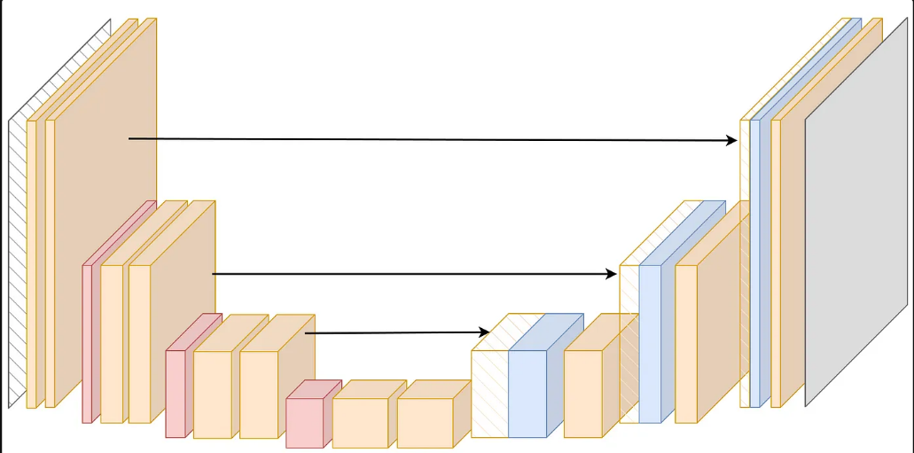
U-Net Generator Model

Slide 11
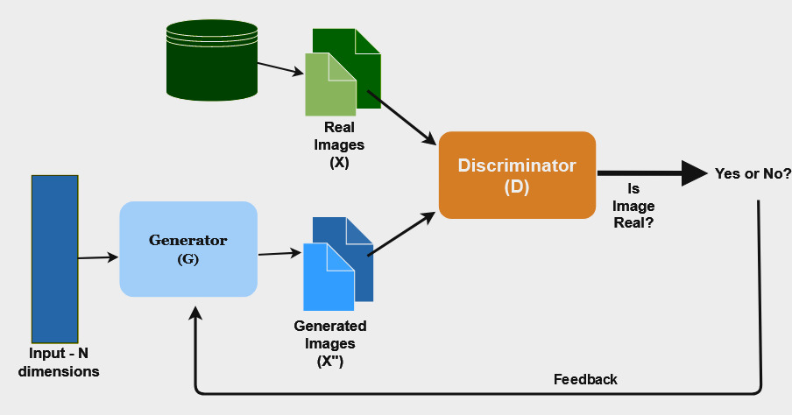
Combined GAN Model

Slide 12
Training Process
In Each Epochs, first the Discriminator is trained
Discriminator is being trained 2 times, first on real data and second on fake data
At first the Discriminator is given a batch of real data labelled as 1(which denotes provided data is real).
After above, It is given a batch of fake data labelled as 0( which denotes provided data is fake)

Slide 13
After training the Discriminator 2 times, The Generator is trained.
The generator is trained using the GAN model and during this the
trainable parameter of Discriminator is set to false.
The generator is given a grayscale image as input and produces a
3 channeled colored image of it.
The output of the generator with its corresponding grayscale image
with its label is provided to the Discriminator.
The label is given as 1 purposely as we need to train the generator
which should be capable of fooling the discriminator.
According to the output the Weights of the model are updated using
Backward Propagation.
This above process is called adversarial training process

Slide 14
Loss Functions
Binary Cross Entropy
Mean Absolute Error
Initialy the Generator will be weak so its output can be easily guessed as fake by the Discriminator so the loss functions are given some weights in the ration (1:100) .
Weight of 1 given to Binary cross Entropy and 100 given to MAE for faster training process

Slide 15
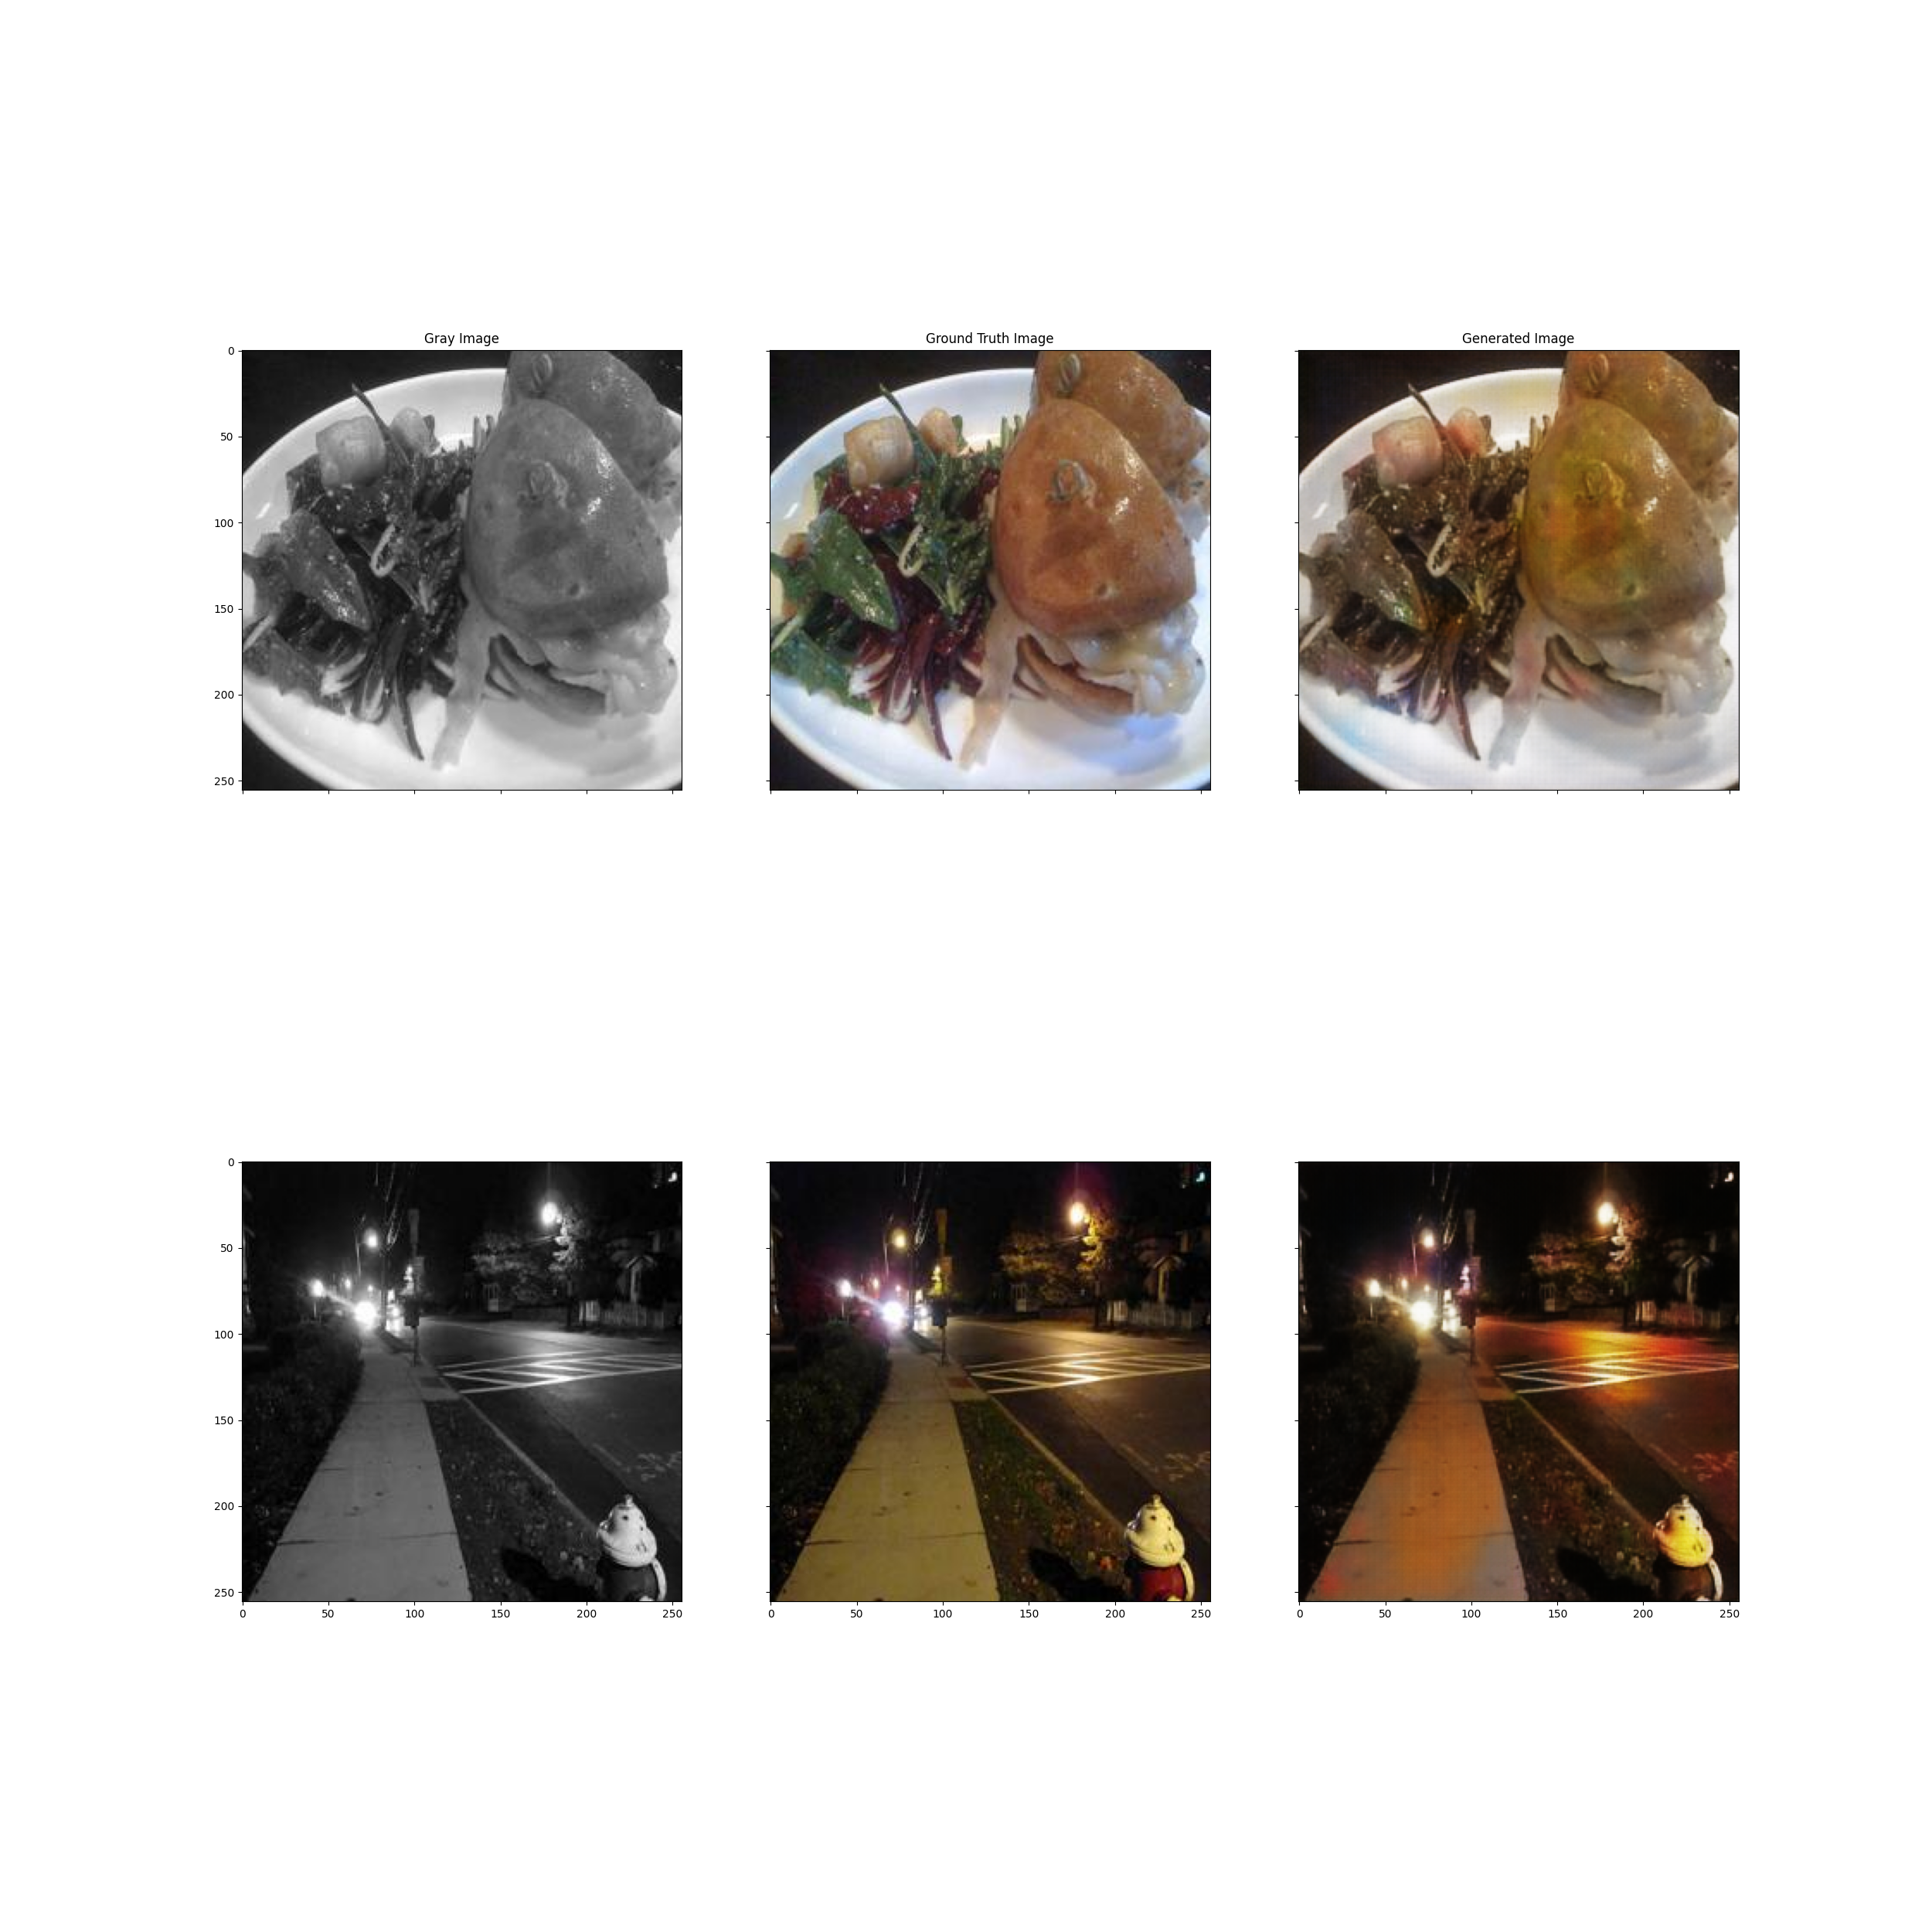
Output

Slide 16
Thank You

